Slide 1
Annuity Provisions & Tax implications Session III

Slide 2
Agenda/ Topics covered
Annuity contract provisions
Tax implications
Advantages of Annuities
Disadvantages of Annuities
Comparison of annuities with other investments
Factors affecting amount of periodic income payments
Types of Annuities - Summary

Slide 3
Annuity Contract Provisions
Many provisions that are typically included in individual life insurance policies are also included in individual annuity contracts.
Free look provision
Gives the policy owner a stated period of time usually 10-15 days after the policy is delivered to examine the policy.
During the free look up period, the policy owner has the right to cancel the policy and receive a full refund of the initial premium payment.

Slide 4
Assignment provision:
Individual annuity contracts generally state that if the contract is part of specified types of qualified retirement plans, the contract may not be sold, assigned, transferred, or pledged as collateral for a loan or for any other purpose to any other person.
Dividends provision:
Most participating annuity contracts state that the insurer does not expect to pay policy dividends. Instead, insurers usually increase the interest rate they pay on participating annuities above the minimum rate guaranteed in the contracts.

Slide 5
Incontestability provision:
Annuity contracts that include certain supplementary benefits limit the time—typically a maximum of two years—during which the insurer may contest the validity of the coverage provided by the supplementary benefit based on a material misrepresentation in the application.
Misstatement of age or sex provision:
States that if the annuitant’s age or sex was misstated in the application, then the annuity benefits payable will be those that the premiums paid would have purchased for the correct age or sex.

Slide 6
Withdrawal provision:
Withdrawal provision gives the contract owner the right to withdraw all or a portion of the annuity’s accumulation value during the accumulation period.
Most contracts allow the contract owner to withdraw a stated percentage of the annuity’s accumulation value each year without charge.

Slide 7
Surrender
An annuity's surrender period is the time during which the investor must keep all or a minimum portion of his or her money in the annuity account or else face surrender fees.
Typically, surrender fees are a percentage of the withdrawal amount. In many cases, the surrender fee declines over time, meaning that in the first year of the surrender period the fee might be 10%, then 9% the next year, 8% the next year, and so on.

Slide 8
Surrender
Purchase price = $100,000
Number of Years = 10-year annuity
Surrender period = 7 Years
Surrender fee = 10%
But, let's assume that emergency has occurred and 2 years later you need $50,000 of your principal back.
Because the surrender period on the annuity has not expired (the surrender period is seven years), you may withdraw the funds early, but you must pay a 10% fee.
i.e $50,000 x 10% = $5,000.

Slide 9

"Nothing can be said to be certain, except death and taxes"
Benjamin Franklin

Slide 10
Taxation In General
Annuities are subject to unique income tax rules spelled out primarily in Section 72 of the Internal Revenue Code. These rules generally have the effect of treating each annuity payment as consisting of two distinct parts.
A nontaxable return of the (nondeductible) premiums that were deposited to the annuity, and
A taxable distribution of the (tax-deferred) interest that the annuity earned during the accumulation or pay-in period.
This general tax scheme applies to both the original annuitant and to any beneficiary who succeeds to the annuity payments after the original annuitant's death.

Slide 11
Qualified & Non-Qualified Annuities
Retirement plans that satisfy the complex legal requirements of the U.S Internal Revenue code and ERISA (Employee Retirement Income Security Act) and as result provide certain favorable tax treatments for both employer and employee are known as Tax qualified plans.
Qualified annuities are purchased to fund or distribute funds from a tax-qualified plan and are exempt from current income taxation during the accumulation period.
Non qualified annuities are type of annuities that has few limitations on the amount that can be invested but that does not receive all of the tax advantages in qualified annuities.

Slide 12
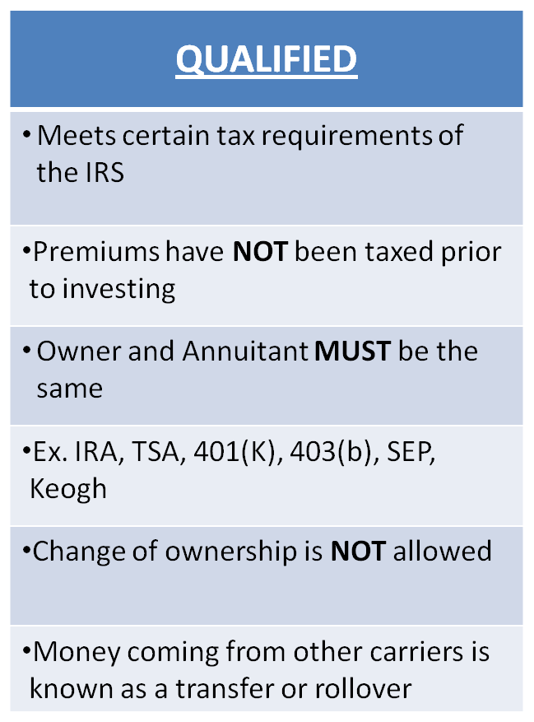
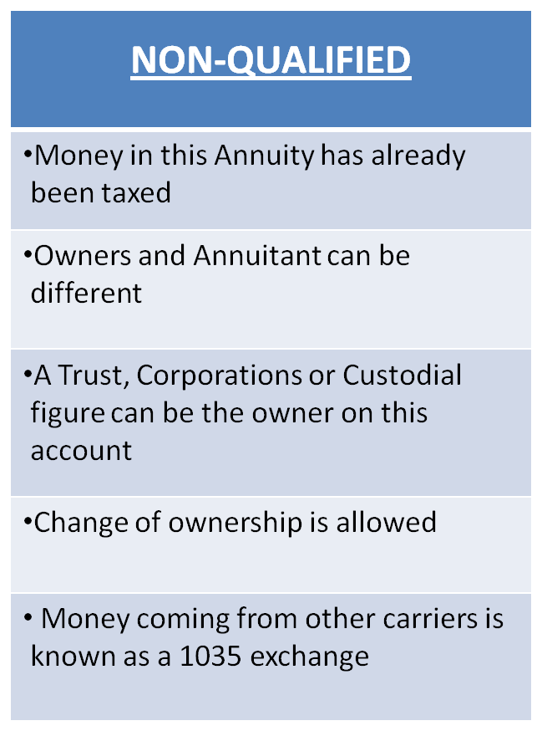

Slide 13
Individual Retirement Arrangement (IRA)
An IRA is a Retirement savings plan that allows a person with taxable compensation to deposit a stated amount of that compensation into a savings arrangement that meets certain requirements specified in the federal tax laws and, thus, receives favourable federal income tax treatment.
An IRA make take over two forms
Individual Retirement Account
Individual Retirement Annuity

Slide 14
Individual Retirement Account
A trust or custodial account issued by a bank or a qualified institution like a savings and loan company, credit union or brokerage firm.
Individual Retirement Annuity
An annuity issued by a insurance company and can be purchased with flexible premiums or a single premium.

Slide 15
The tax treatment of an IRA varies depending on whether it is a traditional IRA or Roth IRA.
Traditional IRA
It is also known as Regular IRA, it is an IRA in which contributions may be deductible and investment earnings are tax deferred until the funds are withdrawn.
Anyone who is less than age 70 ½, and who has taxable compensation may contribute to Traditional IRA.

Slide 16
Roth IRA
A Roth IRA is an IRA that provides for non-deductible contributions annually, but tax free qualified withdrawals.
In other words, contributions are not taxed when they are withdrawn because they were taxed previously.
To qualify for tax-free withdrawals of the investment earnings, the tax payer must
have held the Roth IRA for at least 5 years
Be over age 59 ½

Slide 17
Why Annuities are so popular
Liquidity
Annuities are liquid. Access is available through annuitizing, partial withdrawals, and even full surrender of both principal and interest if desired (subject to any withdrawal charges and/or resulting taxes).
Guarantees
An annuity is usually set up with a fixed rate of interest that is guaranteed for the first year. After that, the rate is determined by the investment performance of the company subject to a guaranteed minimum rate. No other conventional savings method can make the guarantee of a regular income... an income for life.

Slide 18
Tax-Deferred Growth
Money invested in an annuity grows on a tax-deferred basis. Profits are only taxed when they begin to receive an income from the annuity.
Money will grow faster in a tax-deferred annuity than in a taxed investment, such as a CD or mutual fund.
Larger and More Secure Income
Annuity income is often larger than income provided by other conventional savings vehicles, because it's based on a method of using both principal and interest, with no risk of outliving the money.
There is no worry about the principal being exhausted because the income may be guaranteed for life

Slide 19
More Flexibility
Amount of money involved, frequency of payment, length of accumulation period, type of annuity, persons included, payout methods – there are numerous choices and great flexibility in purchasing an annuity.
Bonus Rates
Some annuities award owners with bonuses – extra interest that further increases their money – during the annuity's first year. The bonus increases the annuity's principal on which future interest will be calculated in subsequent years, thus providing a substantial boost to the ultimate value of an annuity policy.

Slide 20
Rate of Return
Annuities offer higher rate of return than other safe investments. Currently, annuities are yielding an average of 4% tax deferred in comparison to only 2% taxable with CDs.
Partial Withdrawal
Many annuity contracts allow owners to access a portion of their contract values (usually around 10%) each year for any reason.
Free Look Period
Virtually all annuity contracts have a free look period, during which the owner can return the contract for a full refund.

Slide 21
Disadvantages of Annuity
Costs& Fees - Annuities are one of the most expensive types of investments available in the financial marketplace.
Annuity Withdrawal Penalties
Income payments cannot be adjusted to reflect changing needs
Decision once made is final, can’t convert an annuity into another form of retirement income.
Complexity – Although annuities can provide tremendous benefits for investors when used correctly, they are by nature complex instruments, especially indexed and variable contracts.

Slide 22

Premium Receipts of U.S Life Insurance Companies

Slide 23
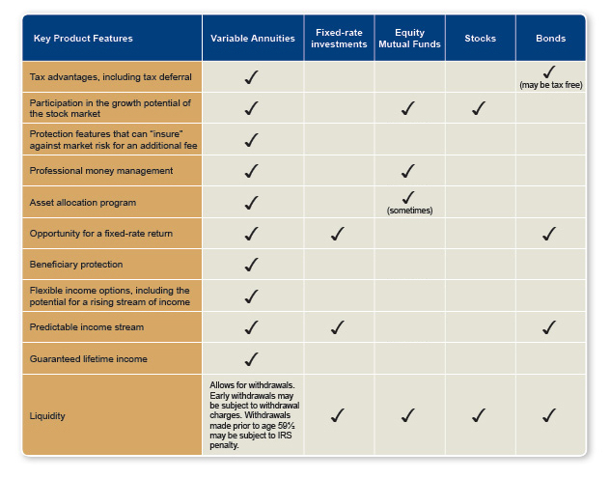
Comparison of Annuities with other investments

Slide 24
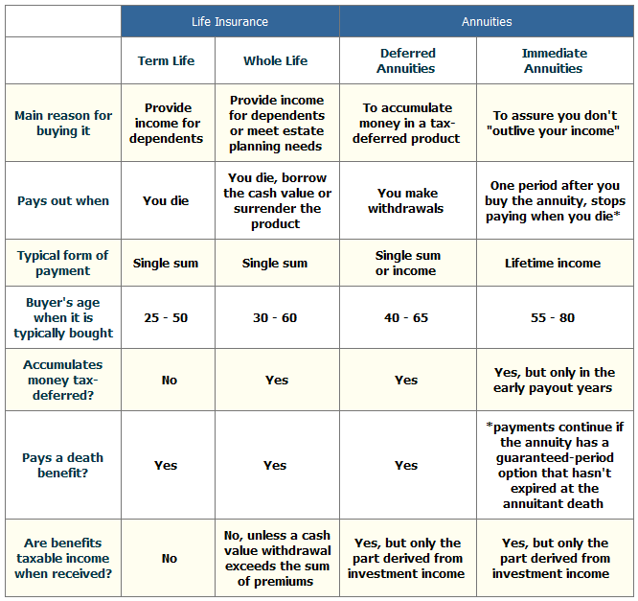

Slide 25
Factors Affecting Amount of periodic income payments
1. The amount of the principal invested
Premiums increase principal. Withdrawals and surrenders decrease principal.
2.The time over which the principal grows at interest.
The Longer the time period, the larger the interest earnings will be.
3. The interest rate that represents investment earnings.
An interest rate will be used to represent the investment earnings.

Slide 26
4. The number & timing of periodic income payments
The number of periodic income payments is determined by the frequency of payments and the total length of the pay-out period.
The number of periodic income payments also depends on depends on mortality experience.
The longer the annuitant is expected to live, all other factors being equal, the smaller the periodic payments will be.
Similarly, the shorter the time period the annuitant is expected to live, all other factors being equal, the larger the periodic income payments.

Slide 27
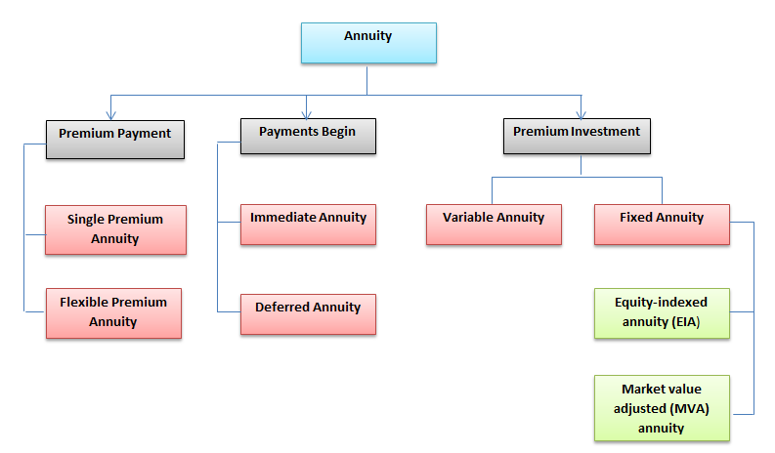
Types of Annuities - Summary

Slide 28


Slide 29

Top 20 annuity sales leaders for 2013

Slide 30


